Slide 1
Course Code:CSC402A Course Title: Web Architecture and Application Development
Course Leader:
Kishore S.M.
kishore.cs.et@msruas.ac.in

Slide 2
Objectives
After completing this lecture, the student will be able to
Describe Message brokers
Describe pipes and filters

Slide 3
Contents
Message brokers
Pipes and Filters

Slide 4
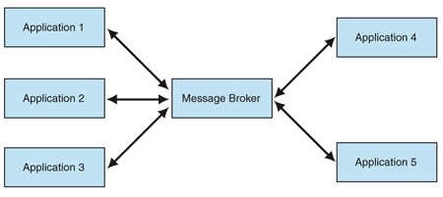
Message Brokers
A message broker mediating the collaboration between participating applications
Message brokers are used
To integrate applications without enforcing a common interface and also allow each application to initiate interactions with several other applications

Slide 5
Message Brokers
Instead of communicating with each other, applications communicate only with the message broker
An application sends a message to the message broker, providing the logical name of the receivers
The message broker looks up applications registered under the logical name and then passes the message to them
Prior to using a message broker, you must register the applications that receive communications so that the message broker can dispatch requests to them
The message broker may provide its own registration mechanism, or it may rely on an external service such as a directory

Slide 6
Message Brokers
Message brokers add logic to the queues and at the level of the messaging infrastructure
Messaging processing is no longer just moving messages between locations but designers can associate rules and processing steps to be executed when given messages are moved around
The downside of this approach
The logic associated with the queues and the messaging middleware might be very difficult to understand
Since it is distributed and there is no coherent view of the whole

Slide 7
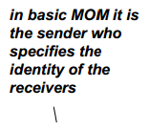
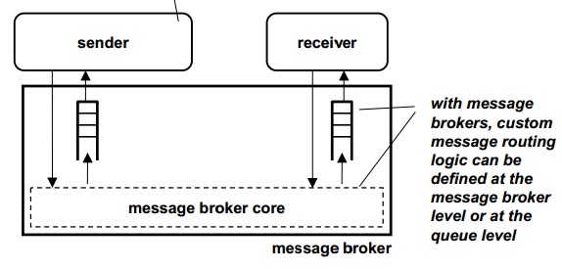
Message Brokers

Slide 8
Message Brokers
Responsibilities
Receive message
Determine the message recipients and perform the routing
Handle any interface-level differences –Send the message to the recipients
Collaborations
Senders: applications that send messages to the message broker
Receivers: applications that receive messages from the message broker

Slide 9
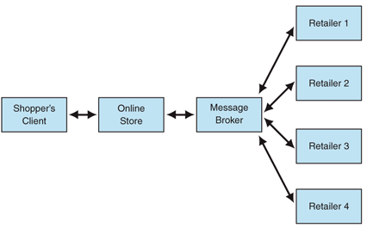
Message Brokers-Example
Online store communicating with retailers through a message broker

Slide 10
Advantages of Message Brokers
Reduced coupling
The message broker decouples the senders and the receivers
Senders communicate only with the message broker, and the potential grouping of many receivers under a logical name is transparent to them
Improved ability to integrate
The applications that communicate with the message broker do not need to have the same interface
Unlike integration through a bus, the message broker can handle interface-level differences
Act as a bridge between applications that are from different security realms and that have different QoS levels

Slide 11
Advantages of Message Brokers
Improved modifiability
Shields the components of the integration solution from changes in individual applications
Enables the integration solution to change its configuration dynamically
Improved security
Communication between applications involves only the sender, the broker, and the receivers
Other applications do not receive the messages that these three exchange
Unlike bus-based integration, applications communicate directly in a manner that protects the information without the use of encryption

Slide 12
Pipes and Filters
A simple, powerful, robust architecture
Consists of any number of components (filters) that transform or filter data, before passing it on via connectors (pipes) to other components
Unix supports a linear pipe and filter architecture called pipeline
Pump
Pipe
Pipe
Pipe
Sink
Filter
Filter

Slide 13
Pipes and Filters
Pipe
Process the stream of input data and turn into some output data
Each component has inputs and outputs
Components compute by performing local transformations on their inputs to produce their outputs
Filter
A conduit that allows the flow of data
The connectors of components transmit the outputs of one component to the inputs of another

Slide 14
Advantages
Filters are self containing processing service that performs a specific function thus it is fairly cohesive
Filters communicate (pass data most of the time) through pipes only, thus it is “somewhat” constrained in coupling
Makes it easy to understand overall function of the system as a
Composition of filter functions
Encourages reuse of filters
Facilitates maintenance

Slide 15
Disadvantages
Filters processes and sends streams of data over pipes is a solution that fits well with heavy batch processing
Not good for interactive applications where you often want to do incremental computations, e.g., incremental display updates
Anything that requires quick and short error processing is still restricted to sending data through the pipes, possibly making it difficult to interactively react to error- events
Can’t coordinate stream inputs

Slide 16
Summary
A message broker mediating the collaboration between participating applications

